Slide 1
Project Presentation
E-commerce web system
United Gemco
http://www.unitedgemco.com/

Slide 2
Architecture
LocalStorage
Header
Dataservice.js
Ng view1
Ng view2
Ng view…..
Need data
Defered Obj
footer
Ajax
Datadao.js
User
Service.js
RESTful
Server.js
Mongo
DB
Dummy
data.js
Item
Service.js

Slide 3
Main Functions
Sliding show in main page
New arrival
Search
Google map import
Account management
Shopping cart
Local storage vs service vs cookie

Slide 4
Stand out part
Filter function
Loading page
Data across multiple Scopes
SPA with angular framework
Code is not DRY!
Code refactoring
Separate data with logic
Extensible & maintainable code block

Slide 5
Maintenance & extension
User configuration
Extensible Module
login modal
loading page
item preview dialog
back-to-top
State design pattern
Nav-right-bar directive
Ng-animate

Slide 6

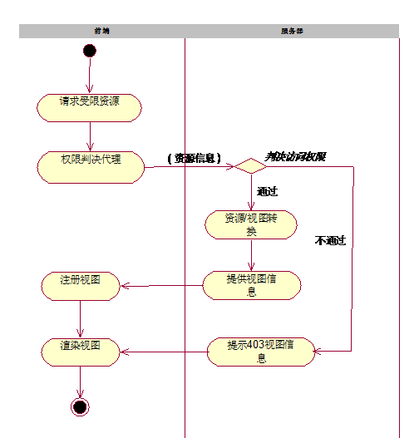
Security – SPA is weaker?
XSS
CSF (Contend Security Policy)
Implement Template engine
Http
OAuth2 -> token ->
$http.jsonp
")]}',\n“
AngularJS
Templates&Expressions
eval

Slide 7
SEO
Google has supported ajax search
https://developers.google.com/webmasters/ajax-crawling/docs/learn-more
Follow Progressive enhancement!
Ugly URL -> Pretty URL
http://www.ruanyifeng.com/blog/2013/07/how_to_make_search_engines_find_ajax_content.html
For non-google search engine:
Make big change
Pre-render pages: phantomjs, prerender.io

Slide 8
Responsive Design & Cache
Responsive Design
Resize
Multiple types of client
Cache
Third-party APIs(from remote to local)
Redis(REmote DIctionary Server)
Frequently get materials(from hard disk/database to memory)

Slide 9
Todo List
Pagination
Unit testing:
Protractor
mocha & jasmine
Cross Browser Issue
IE is disappearing
Dependencies Injection:
Require.js
CSS Modules
Sass, Less

Slide 10
Thanks!
Thanks again…!

